Slide 1
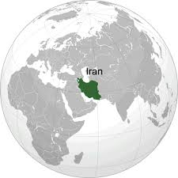
Present Status of Spectrum Monitoring in Iran
Nazi Homayounnasab
Radio Monitoring Office
Communication Regulatory Authority (CRA)
11 March 2014
Iran-Tehran

Slide 2
content
1
2
3
Role of spectrum monitoring
Spectrum Monitoring Plan
CRA as Regulator
4
5
6
Programs & Indicators
Future Plan
ITU measurement

Slide 3
1
CRA as Regulator

Slide 4
Regulator Goals
Regulations
Regulator
Industry
Centers R&D
Open Competition
Protect the rights
of CLIENT
Entrance of various services
Increase Revenue

Slide 5
Organizational chart in view point of radio service
President of CRA
Vice president of CRA for Monitoring and Regulation enforcement
Radio Monitoring Service Department
Vice president of CRA for Technical investigation and Licensing
Radio Service Licensing Department
International Specialized Organization Bureau
Communications Regulatory Commission
Regional Administration

Slide 6
2
Role of spectrum monitoring

Slide 7
Spectrum Management
Spectrum Monitoring
Legal & Regulatory foundation for NSMS
Spectrum Planning and Allocation
Spectrum Engineering
Rules, Regulations and associated standards
Frequency coordination and notification
Licensing, Assignment and billing
Inspection of radio installations
Lawenforcement

Slide 8
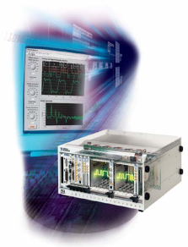
Why do we monitor the spectrum?
Provides data to support spectrum management process (including interference analysis)
Quality of Service
Ensures compliance with regulations
Usage statistics & characteristics
Enforcement
Keeping the spectrum clean for authorized users (guarantee the spectrum licensing)
Future spectrum planning
Interference resolution
Site planning & Maintenance activities
Spectrum resource management
Guarantee the spectrum licensing
Notes:
Increasing demand for radio based services
Monitoring as the eyes and ears of spectrum management
Efficient surveillance to the spectrum (limited resource)
Increasing profitability for regulator

Slide 9
3
Spectrum Monitoring Plan

Slide 10
Standard
Any part of a country should be measured by DF system.
It is not possible in a long-term plan with unlimited spending in most developed countries
Spectrum Monitoring Handbook – Season 2:

Slide 11
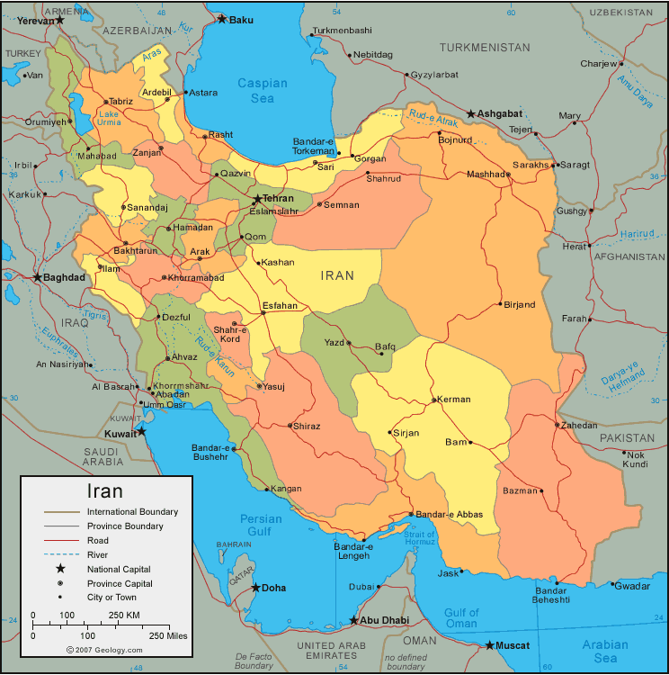
راهکار عملی
Logical way to expand monitoring coverage
تقسیم کشور به سلول هایی با اندازه پوشش استاندارد یک سامانه مانیتورینگ
تعیین شاخص برای اندازه گیری سلول
اولویت بندی سلول ها بر اساس شاخص های تعیین شده
اجرای طرح در یک برنامه بلند مدت
The country is divided into cells where has the area in 100 kilometer diameter which is covering entire places and cities. Indexes to measure the Cell for assigning the special monitoring and DF equipment Prioritize and classify cells based on indicators Implement a long-term plan

Slide 12
Indexes
Statistics of radio violations and radio interferences
Geographical parameters (population, area, mountainous and humidity)
Strategic factor (priority sovereignty, territorial and industrial)
The number of assigned frequencies

Slide 13
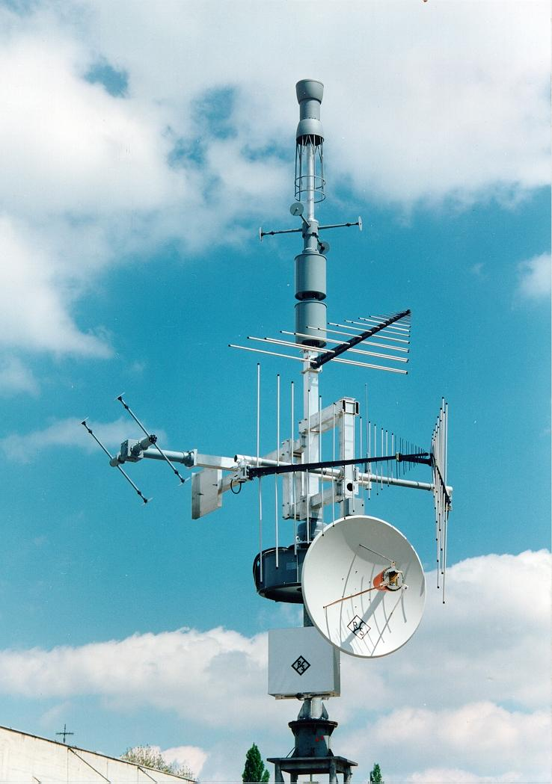
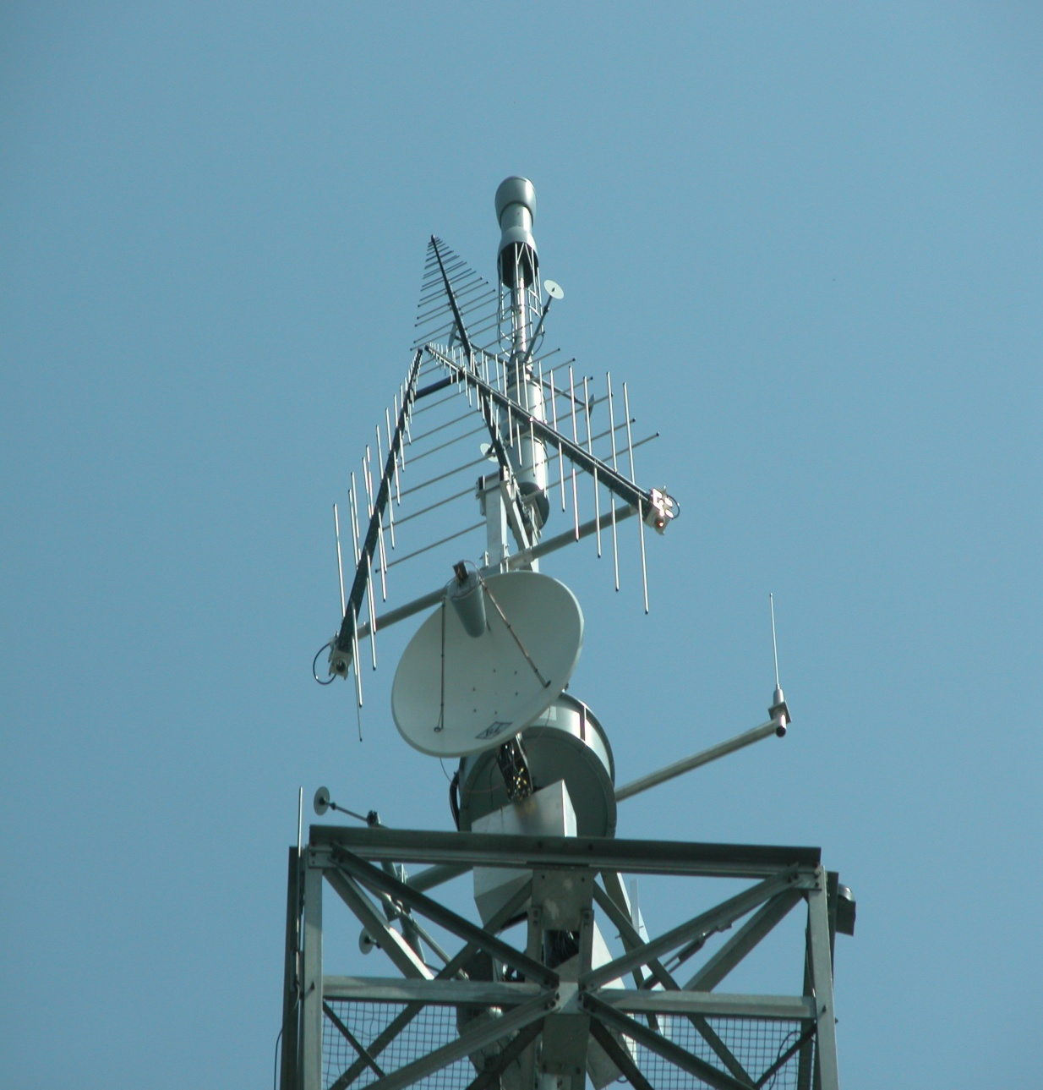
Remote Monitoring System-Fixed (RMS-F)
Notes:
The equipment available at a radio monitoring station should be suitable to perform the measurements
required at that station. The measurements are derived from the tasks that the station has been assigned.
These tasks in turn depend on the purpose and goals of radio monitoring within the country as covered in
§§ 1.3 and 2.3. The nature and quality of the measurements will determine which types of equipment are
necessary.

Slide 14
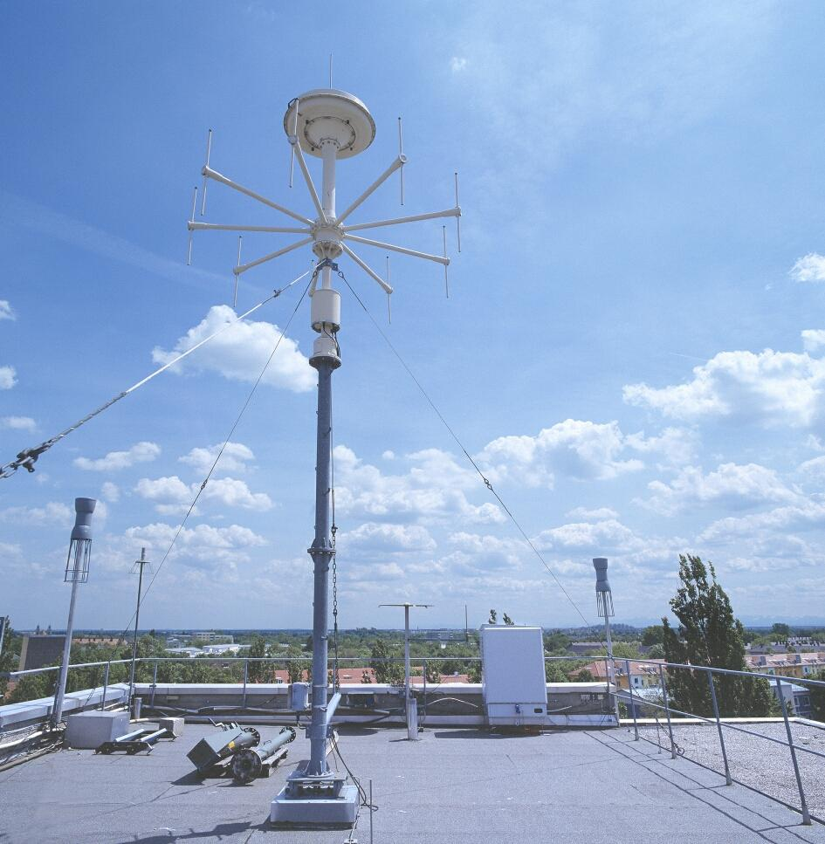
Remote Monitoring & DF System-Fixed (RMS-F)

Slide 15
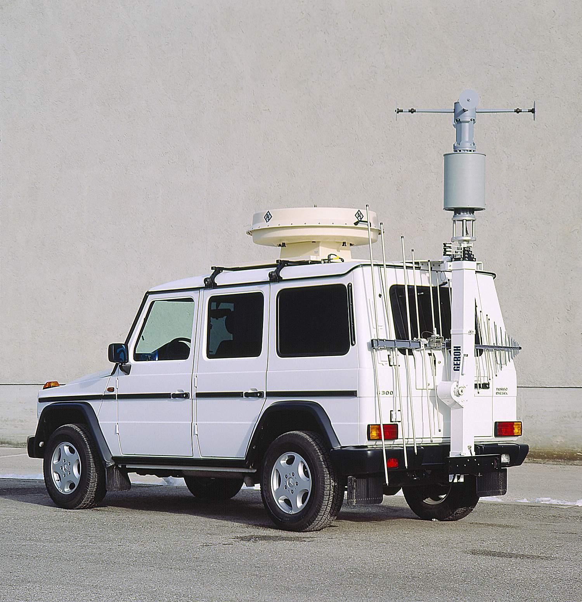
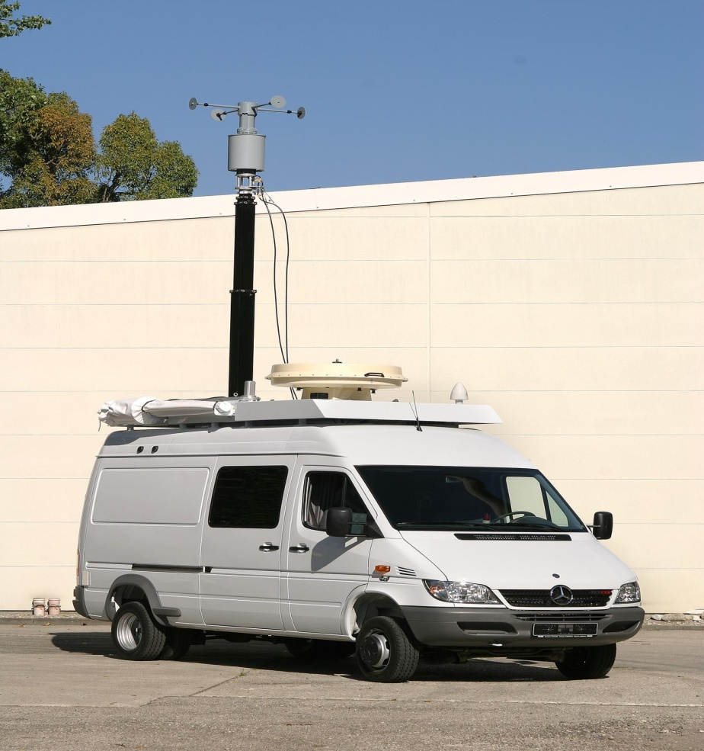
Remote Monitoring System –Mobile (RMS-M)

Slide 16
National Monitoring Center
Focused center is for controlling and monitoring the operation
of the various radio systems
Cover all over the county
Connect to all fixed and mobile spectrum monitoring, DF &
PF systems
Cover the entire frequency range of HF, VHF, UHF and SHF
Notes:
The system for controlling and monitoring the operation of the various radio systems has focused on the scope and coverage of its location and the width of the entire spectrum of surveillance systems, including radio navigation systems, monitoring systems, positioning systems either settlement or moving the entire frequency range of HF, VHF, UHF and SHF are included.

Slide 17
Structure of National Monitoring Center (NMC) with Monitoring & Control Center

Slide 18
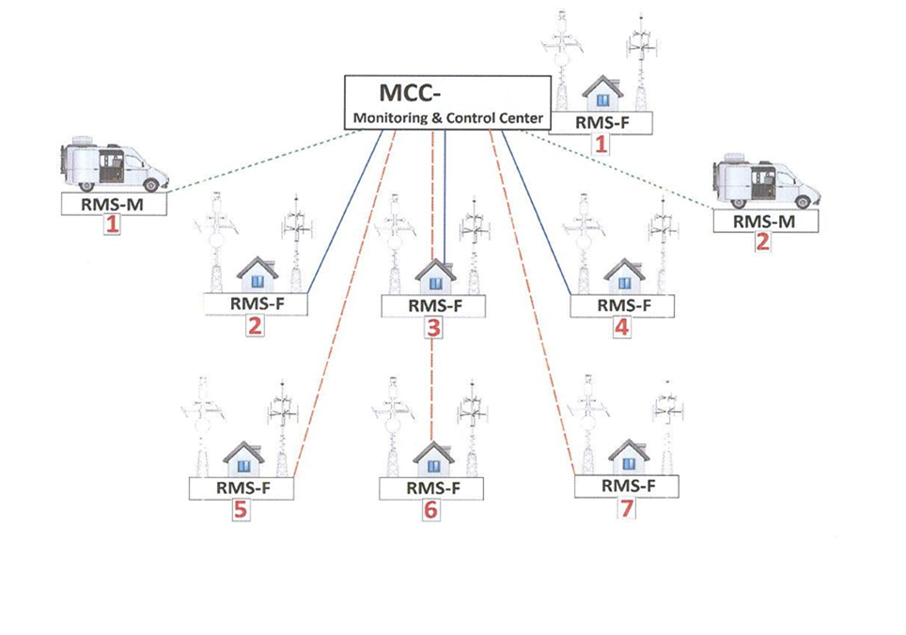
Structure of Monitoring & Control Center
X
Microwave Link:
VSAT Link
GSM/VPN Link

Slide 19
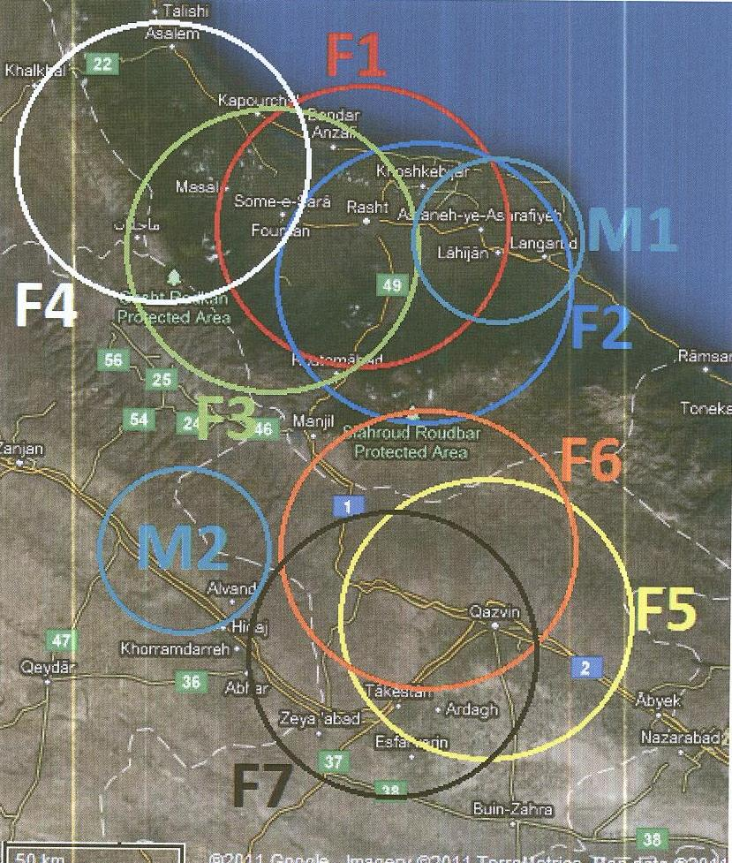
1 MCC with 7 RMS-F and 2 RMS-M

Slide 20
4
ITU measurement

Slide 21
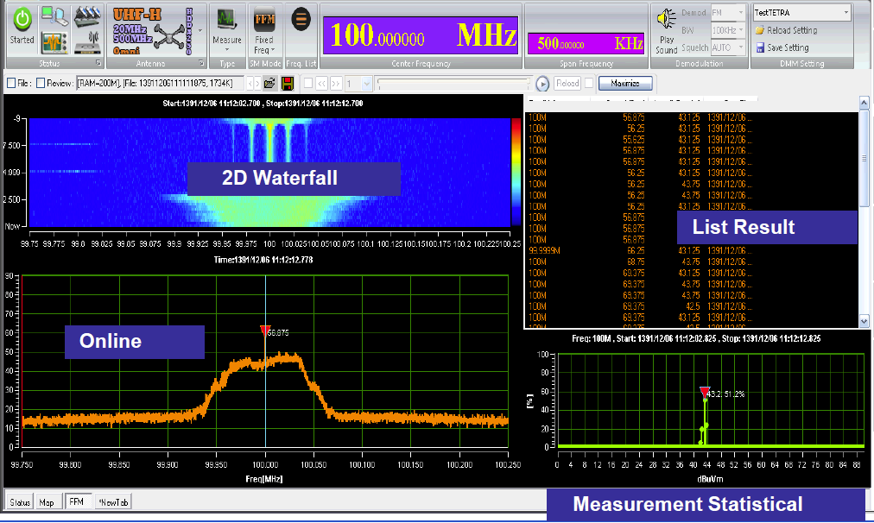
ITU measurement
Frequency measurement
Field strength or PFD measurement
Modulation measurement
Occupancy measurement
Band width measurement

Slide 22
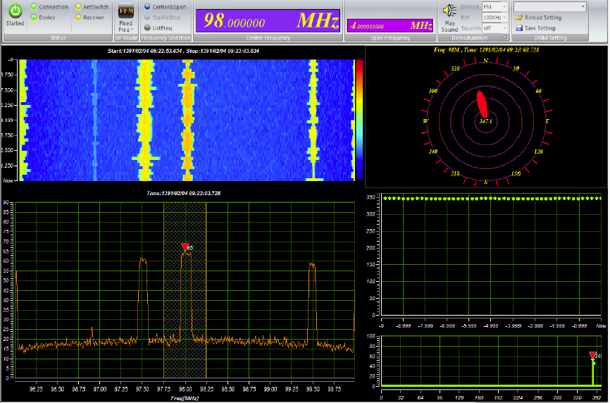
ITU measurement
Direction Finding
Position Finding

Slide 23
Inspection
Effective means of regulating
Ensuring more efficient use of the spectrum
Ensures radio facilities are installed and operating in accordance with their
assigned operating parameters
For example
excessive power
error in the transmitter location
The approaches include plans such as:
inspection of all newly authorized installations;
inspections based on cause
increased number of interference reports
discovery of rule infractions
inspecting a percentage of all stations on a random sampling
Notes:
The inspection of radio installations is an effective means of regulating and ensuring more efficient use of
the spectrum because it ensures that radio facilities are installed and operating in accordance with their
assigned operating parameters. Stations operating outside their authorized operating parameters (for
example, excessive power, or an error in the transmitter location) have greater potential for causing
interference, and will impact new authorizations on co-channel and adjacent channel frequencies
A number of different approaches may be taken by administrations in planning and implementing
inspections of radio facilities. The approaches include plans such as:
– inspection of all newly authorized installations;
– inspections based on cause (for example, increased number of interference reports, or discovery of
rule infractions), and
– inspecting a percentage of all stations on a random sampling or other statistical basis ) Report ITU-R SM.2130(

Slide 24
5
Programs & Indicators

Slide 25
Annual Monitoring Programs
3 months program for mobile spectrum monitoring for C&D cells
Program for inspection of radio installations of users (Annually & Randomly)
24 hours program for each RMS-F(3 months program)
3 months program for monitoring the borders for controlling and elimination of spillover

Slide 26
Macro Indicators
For instance(6 indicators)
Spectrum Monitoring
(Monitored channels/ programmed channels to be monitored for a period)× 100
Inspection of radio installation
(Inspected radio networks/ All licensed radio networks in the region)× 100
The ability of eliminating the interferences
(Analyzed interferences/proclaimed interferences )× 100

Slide 27
Micro Indicators
For instance (50 indicators)
Numbers of monitored frequency channels (Fixed & Mobile Stations)
Numbers of active assigned frequency channels (Fixed & Mobile Stations)
Numbers of non-active assigned frequency channels (Fixed & Mobile Stations)
Numbers of free frequency channels (Fixed & Mobile Stations)
Numbers of unauthorized frequency channels (Fixed & Mobile Stations)
Numbers of identified, analyzed, eliminated interferences (Fixed & Mobile Stations)

Slide 28
6
Future Plan

Slide 29
Future Plan
Completion of radio monitoring stations installation in A,B cells
Upgrading the old equipments
Be equipped for Maritime monitoring and Fixed Satellite monitoring
Study the new methods of spectrum monitoring by new equipments

Slide 30
Homayounnasab@cra.ir

